Slide 1
CAPSTONE PROJECT
FINAL PRESENTATION
On
Determining the best Neighbourhood
( Battle Of Neighbourhood )
By :- Sonalika Ray

Slide 2
1. Introduction
Background :- Safety is a top concern when moving to a new area. If you don’t feel safe in your home , you’re not going to be able to enjoy living there
Problem :- The problem aims to select the safest bourough in London based on the total crimes , explore the neighbourhoods of that borough to find the 10 most common venues in each neighbourhood and finally cluster the neighbourhoods using k-clustering
Interest :- Expats who are considering to relocate will be interested to identify the safest borough in London and explore its neighbourhoods and common venues around each neighbourhood.

Slide 3
2. Data Acquisition and Cleaning
Data Acquisition : The data acquired for this project is a combination of data from three scources :-
The first data source of data of the project uses a London crime data that shows the crime per borough in London.
The second source of data is scraped from a wikipedia page that contains the list of London boroughs. This page contains additional information about their boroughs.
The Third data source is the list of neighbourhoods in the Royal Borough of Kingston upon Thames as found on the wikipedia page

Slide 4
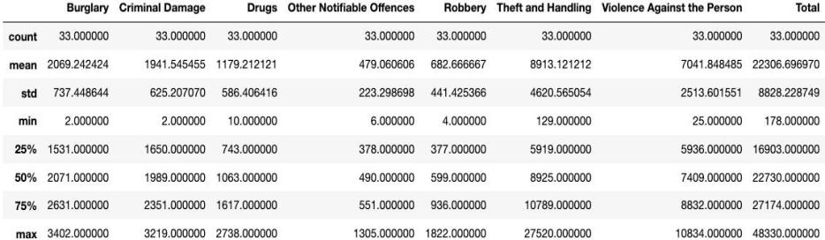
3. METHODOLOGY
Exploratory Data Analysis
Statistical Summary Of Crimes
Statistical description of the London crimes
The count for each of the major categories of crime returns the value 33 which is
the number of London boroughs. ‘Theft and Handling’ is the highest reported crime
during the year 2016 followed by ‘Violence against the person’, ‘Criminal
damage’. The lowest recorded crimes are ’Drugs’, ‘Robbery’ and ‘Other Notifiable
offenses’.

Slide 5
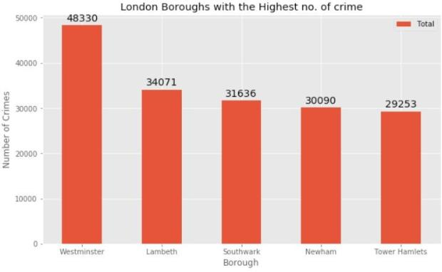
Boroughs with the highest crime rates
Comparing five boroughs with the highest crime rate during the year 2016 it is
evident that Westminster has the highest crimes recorded followed by Lambeth,
Southwark, Newham and Tower Hamlets. Westminster has a significantly higher
crime rate than the other 4 boroughs
Boroughs with the highest crime rates

Slide 6
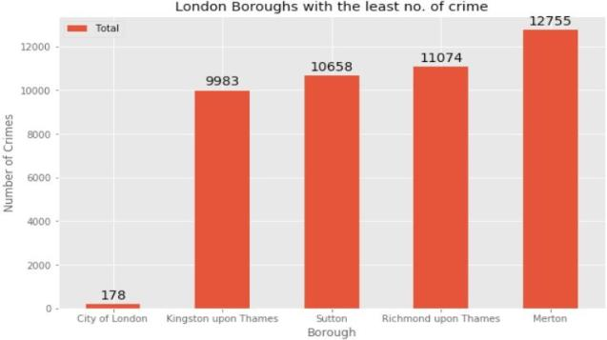
Boroughs with the lowest crime rates
Comparing five boroughs with the lowest crime rate during the year 2016, City of
London has the lowest recorded crimes followed by Kingston upon Thames, Sutton,
Richmond upon Thames and Merton
City of London has a significantly lower crime rate because it is the 33rd principal
division of Greater London but it is not a London borough. It has an area of 1.12 square
miles and a population of 7000 as of 2013 which suggests that it is a small area.
Hence, we will consider the next borough with the lowest crime rate as the safest
borough in London which is Kingston upon Thames.

Slide 7
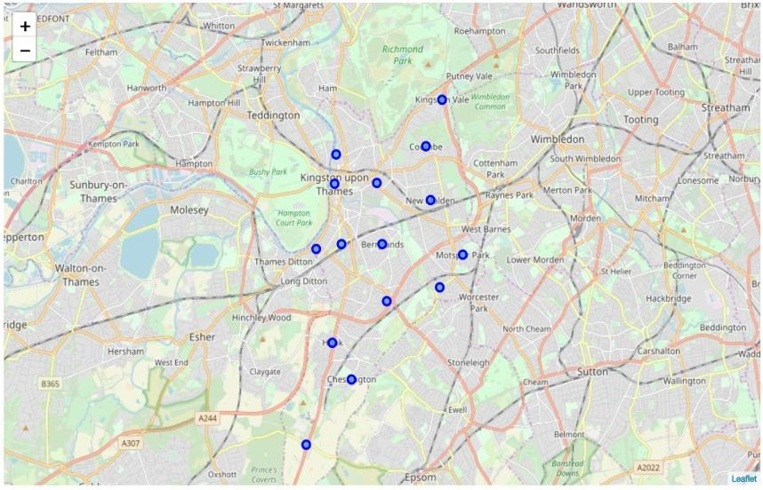
Neighborhoods in Kingston upon Thames
There are 15 neighborhoods in the royal borough of Kingston upon Thames, they
are visualised on a map using folium on python.

Slide 8
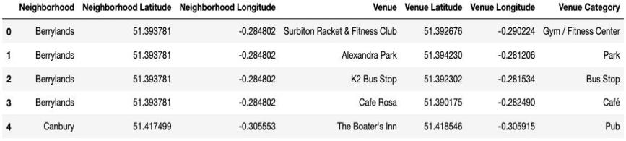
Modelling
Using the final dataset containing the neighborhoods in Kingston upon Thames along with the latitude and longitude, we can find all the venues within a 500 meter radius of each neighborhood by connecting to the Foursquare API. This returns a json file containing all the venues in each neighborhood which is converted to a pandas dataframe. This data frame contains all the venues along with their coordinates and category
Venue details of each Neighborhood
One hot encoding is done on the venues data. (One hot encoding is a process by which categorical variables are converted into a form that could be provided to ML algorithms to do a better job in prediction). The Venues data is then grouped by the Neighborhood and the mean of the venues are calculated, finally the 10 common venues are calculated for each of the neighborhoods.
To help people find similar neighborhoods in the safest borough we will be clustering similar neighborhoods using K - means clustering which is a form of unsupervised machine learning algorithm that clusters data based on predefined cluster size. We will use a cluster size of 5 for this project that will cluster the 15 neighborhoods into 5 clusters. The reason to
conduct a K- means clustering is to cluster neighborhoods with similar venues together so that people can shortlist the area of their interests based on the venues/amenities around each neighborhood.

Slide 9
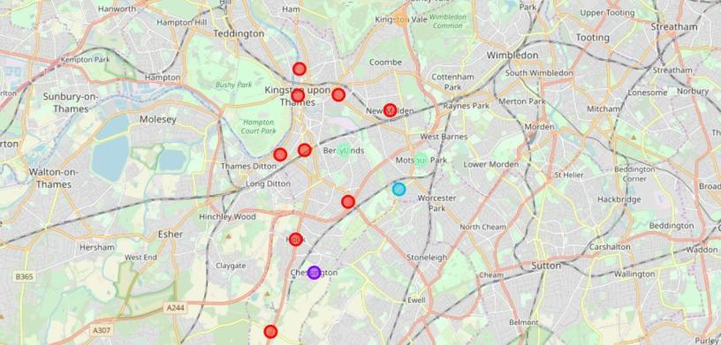
4. Results
After running the K-means clustering we can access each cluster created to see which neighborhoods were assigned to each of the five clusters. Looking into the neighborhoods in the first cluster
Each cluster is color coded for the ease of presentation, we can see that majority of the neighborhood falls in the red cluster which is the first cluster. Three neighborhoods have their own cluster (Blue, Purple and Yellow), these are clusters two three and five. The green cluster consists of two neighborhoods which is the 4th cluster.

Slide 10
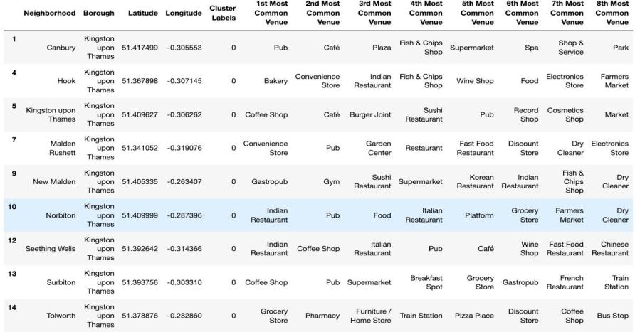
Cluster 1:- Looking into the neighbourhoods of Cluster 1
The cluster one is the biggest cluster with 9 of the 15 neighborhoods in the borough Kingston upon Thames. Upon closely examining these neighborhoods we can see that the most common venues in these neighborhoods are Restaurants, Pubs, Cafe, Supermarkets, and stores.

Slide 11
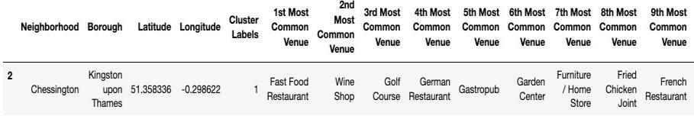
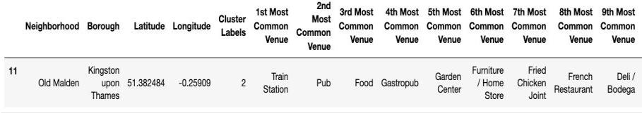
Cluster 2 :- Looking into the neighbourhood in the second cluster
The second cluster has one neighborhood which consists of Venues such as Restaurants, Golf courses, and wine shops.
Cluster 3 :- Looking into the neighbourhood in the third cluster
The third cluster has one neighborhood which consists of Venues such as Train stations, Restaurants, and Furniture shops.

Slide 12
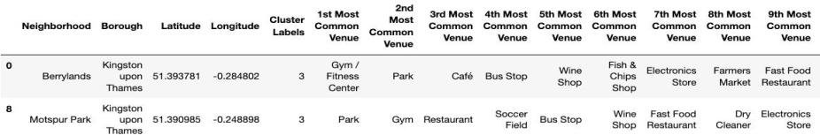
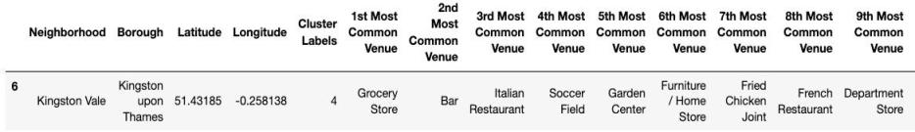
Cluster 4 :- Looking into the neighbourhood in the fourth cluster
The fourth cluster has two neighborhoods in it, these neighborhoods have
common venues such as Parks, Gym/Fitness centers, Bus Stops, Restaurants,
Electronics Stores and Soccer fields
Cluster 5:- Looking into the neighbourhood in the fifth cluster
The fifth cluster has one neighborhood which consists of Venues such as Grocery
shops, Bars, Restaurants, Furniture shops, and Department stores. We will look
into the neighbourhoods in the fourth cluster

Slide 13
5. Discussion
The aim of this project is to help people who want to relocate to the safest
borough in London, expats can chose the neighborhoods to which they
want to relocate based on the most common venues in it. For example if a
person is looking for a neighborhood with good connectivity and public
transportation we can see that Clusters 3 and 4 have Train stations and Bus
stops as the most common venues. If a person is looking for a
neighborhood with stores and restaurants in a close proximity then the
neighborhoods in the first cluster is suitable. For a family I feel that the
neighborhoods in Cluster 4 are more suitable dues to the common venues
in that cluster, these neighborhoods have common venues such as Parks,
Gym/Fitness centers, Bus Stops, Restaurants, Electronics Stores and
Soccer fields which is ideal for a family. The choices of neighborhoods
may vary from person to person.

Slide 14
6. Conclusion
This project helps a person get a better understanding of the neighborhoods
with respect to the most common venues in that neighborhood. It is always
helpful to make use of technology to stay one step ahead i.e. finding out
more about places before moving into a neighborhood. We have just taken
safety as a primary concern to shortlist the safest borough of London. The
future of this project includes taking other factors such as cost of living in
the areas into consideration to shortlist the borough, such as filtering areas
based on a predefined budget.

